Slide 1

 | S.S.V.P.S’s B. S. Deore Polytechnic, Dhule Department of Computer Engineering Academic Year : 2025-2026
SEMINAR AND PROJECT INITIATION COURSE
Sem : CO 5 K |  | SPI – 315003 | Date : 11 Oct’ 2025
Topic : Student Skills and Course Recommendation System
Roll No. |  | Name of Student
02 |  | Gaytri Rajendra Khairnar
05 |  | Sanskriti Nitin Thakare
16 |  | Tejashri Jitendra Borse
74 |  | Sonali Mahesh Patil

Slide 2
Contents
Abstract
Introduction
Literature Review
Information to Seminar topic
Advantages and Disadvantages
Conclusion
Project Initiation :
Description of problem statement.
Scope and objectives.
Stake holder
Platform/ Equipment/ Resources identification.
Bibliography
References

Slide 3
Abstract
The Student Skills and Course Recommendation System is a proposed platform that helps students identify suitable courses based on their skills, interests, academic background and career goals. Students may find it difficult to choose from the large number of courses available online and in educational institutions. The proposed system collects student information and compares it with course requirements.
The system can use rule-based matching or recommendation algorithms to suggest relevant courses. It aims to support informed decision-making, make course discovery easier and help students identify skills they may need to improve. Recommendations should be reviewed by students, teachers or career counsellors before a final decision is made.

Slide 4
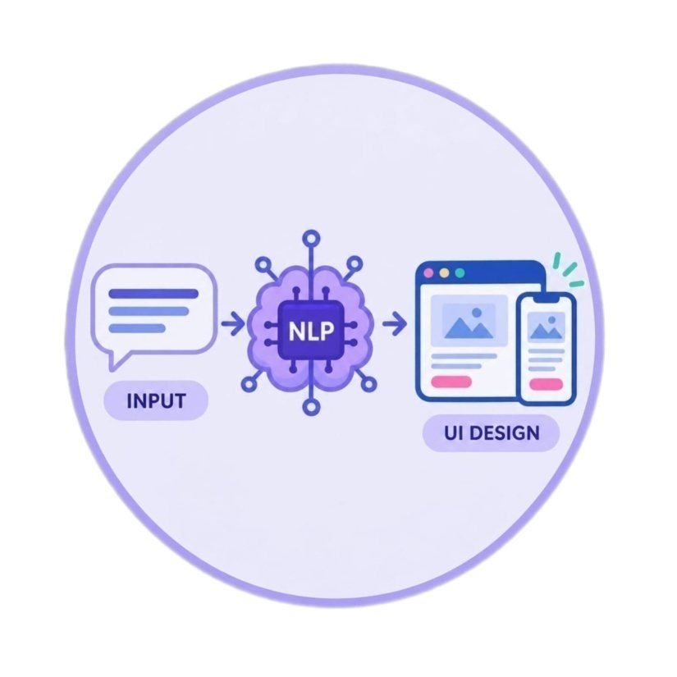
1. Introduction
Choosing the right course is an important step in a student's education and career.
A student's skills and interests can help guide course selection.
Many students are unaware of all the courses related to their abilities.
Course information may be spread across different websites and institutions.
A recommendation system can compare student profiles with course details.
Artificial Intelligence (AI) and recommendation techniques can support personalized suggestions.
The proposed system aims to make course discovery easier and more organized.

Slide 5
2. Literature Survey
Sr. No.s | Approach Type | Technologies Used | Dataset | Key Objective | Limitations
1 | Content-based recommendation | Course attributes, skill tags, matching rules | Course descriptions and student skill profiles | Suggest courses sharing relevant skills and topics | Depends on accurate course tags
2 | Collaborative filtering | Recommendation algorithms, user-item ratings | Course ratings or interaction history | Recommend courses liked by similar learners | Needs sufficient interaction data
3 | Rule-based matching | If-then rules, prerequisite matching | Student profile and course prerequisites | Match skills and goals to course requirements | Rules require regular updates

Slide 6
Sr. No. | Approach Type | Technologies Used | Dataset | Key Objective | Limitations
4 | Profile-based recommendation | Web forms, databases, filtering | Student interests, education and goals | Create suggestions from individual profiles | Profile details may be incomplete
5 | Machine-learning recommendation | Classification or ranking models | Historical course-selection data | Rank courses likely to be relevant | Model quality depends on data
6 | Hybrid recommendation | Content-based + collaborative methods | Course data and user interactions | Combine multiple signals for better suggestions | More complex to build and maintain

Slide 7
Sr. No. | Approach Type | Technologies Used | Dataset | Key Objective | Limitations
7 | Skill-gap analysis | Skill mapping, prerequisite comparison | Skills required and skills reported | Show skills a learner may need to develop | Self-reported skills may be inaccurate
8 | Feedback-based refinement | Ratings, feedback forms, analytics | Student feedback and clicks | Improve future recommendations | Feedback may be limited or biased
9 | Career-goal matching | Career taxonomy, course metadata | Career interests and course outcomes | Connect courses with longer-term goals | Career goals can change over time

Slide 8
Sr. No. | Approach Type | Technologies Used | Dataset | Key Objective | Limitations
10 | Search and filtering | Keyword search, filters, database queries | Course catalogue | Help students narrow course options | Requires clear search terms
11 | Personalized learning paths | Prerequisite graphs, sequencing rules | Course levels and prerequisites | Suggest an order for learning related skills | Path may not fit every learner
12 | Explainable recommendations | Match scores, feature-based explanations | Student profile and course attributes | Explain why a course was suggested | Explanations may be simplified

Slide 9
3. Information to seminar topic
Technology: Recommendation systems, databases, web technologies and optional Artificial Intelligence (AI) or Machine Learning (ML).
Main Purpose: To recommend courses based on students' skills, interests and goals.
Key Concept: Match student profiles with course prerequisites, learning outcomes and skill requirements.
Approach: Collect student information, process it, compare it with course data and display relevant suggestions.
Main Benefit: Supports course discovery and helps students make more informed choices.
Applications: Schools, colleges, online learning platforms, career guidance portals and skill-development programs.

Slide 10
4. Advantages / Disadvantages
Advantages:
Provides course suggestions based on student profiles.
Helps students explore courses related to their interests.
Makes course information easier to organize and search.
Can identify skills that students may need to develop.
Can save time compared with searching manually.
Can be updated as new courses and skills are added.
Disadvantages:
Recommendations depend on the accuracy of student information.
Incomplete course data can reduce recommendation quality.
Students may receive unsuitable suggestions if their interests are unclear.
Personal data must be stored and handled securely.
The system may not fully understand personal circumstances.
Teacher or counsellor guidance is still valuable.

Slide 11
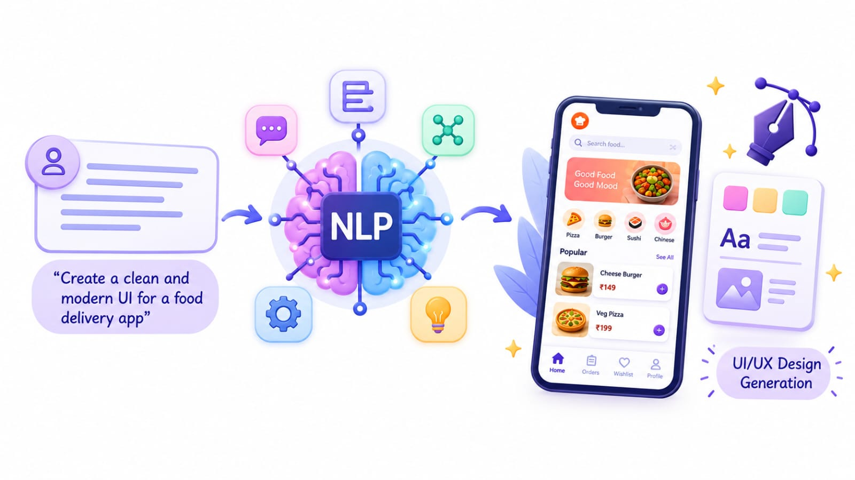
5. Conclusion
The Student Skills and Course Recommendation System aims to help students explore courses that match their skills, interests and educational goals. By organizing student profiles and course information, the system can provide relevant suggestions and make course selection more convenient. Its usefulness depends on accurate data, clear recommendations and responsible handling of personal information. It should support students' decisions rather than make decisions for them.

Slide 12
6. Project Initiation
The proposed Student Skills and Course Recommendation System addresses the difficulty students may face when selecting courses from a wide range of options. Students may not know which courses match their current skills, interests or future goals.
The proposed system collects relevant student details and compares them with course information such as prerequisites, topics and skills taught. It then displays courses that may be suitable for the student.
The project aims to organize course discovery, provide personalized guidance and help students make better-informed choices.

Slide 13
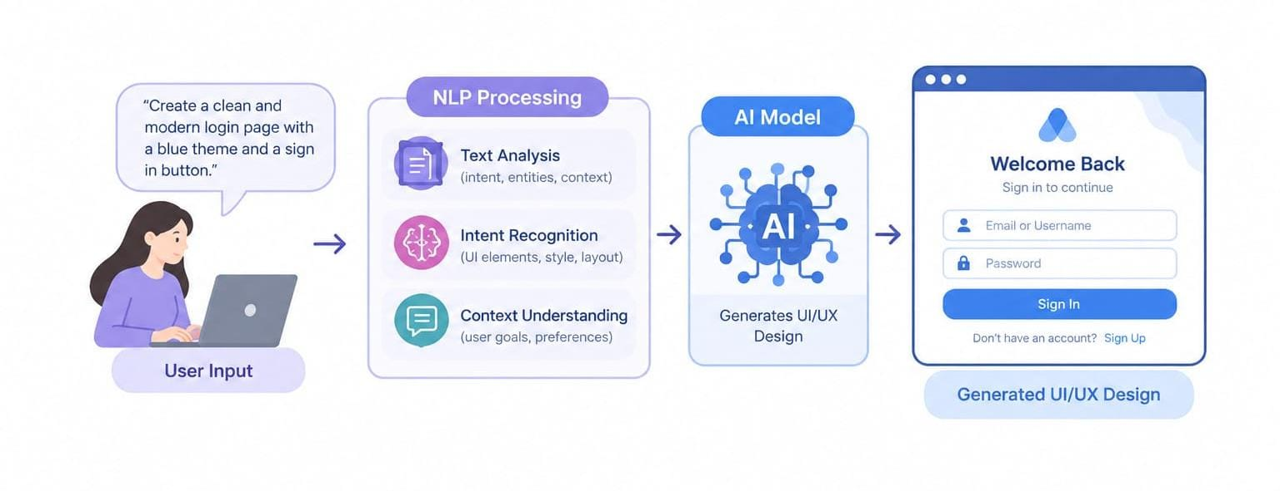
6(a) Problem Statement
Students often find it difficult to choose suitable courses because course information is spread across different sources and the relationship between skills, interests and course requirements may not be clear.
Manual searching can take time, and students may overlook courses that fit their goals. The proposed system aims to address this problem by matching student profiles with available course information and presenting relevant recommendations. The recommendations are intended as guidance and should not replace independent judgement or advice from teachers and counsellors.

Slide 14
6 (b) Scope and Objective
Objectives:
Collect student skills, interests and learning goals.
Maintain a structured list of courses and their requirements.
Compare student profiles with course information.
Recommend courses that may match the student's profile.
Present course details in a clear and user-friendly format.
Allow course data and recommendations to be updated.
Scope:
Course discovery for students and learners.
Basic profile creation and skill selection.
Course matching based on skills, interests and prerequisites.
Display of course descriptions and relevant details.
Possible future addition of AI/ML-based recommendations.
Future improvement through student feedback and updated course data.

Slide 15
6 (c) Stake holders
Students:
Provide skills, interests and learning goals, then review suggested courses.
Teachers and Career Counsellors:
Help students interpret recommendations and make informed choices.
Course Providers / Institutions:
Provide accurate course descriptions, prerequisites and learning outcomes.
Project Team:
Design, develop, test and maintain the system.
Project Guide:
Provide guidance, review progress and evaluate the project.
System Administrator:
Maintain course records, user access and data security.

Slide 16
6 (d) Platform / Equipment / Resources identification
1. Development Platform
Windows or Linux operating system.
Python or JavaScript development environment.
Web browser for viewing and testing the website.
2. System Equipment
Computer or laptop for development and testing.
Internet connection for research and accessing course information.
Keyboard and mouse for development work.
3. Supporting Resources
HTML and CSS for the website interface.
Python / JavaScript for application logic.
A database such as MySQL or MongoDB, if included in implementation.
Course information, skill lists and sample student profiles.
Visual Studio Code or a similar code editor.
Documentation on recommendation systems and data privacy.

Slide 17
Bibliography
Books
Recommender Systems: An Introduction — Dietmar Jannach, Markus Zanker, Alexander Felfernig and Gerhard Friedrich.
Artificial Intelligence: A Modern Approach — Stuart Russell and Peter Norvig.
Software Engineering — Ian Sommerville.
Websites
Python Official Website — https://www.python.org
scikit-learn User Guide — https://scikit-learn.org/stable/user_guide.html
Google for Developers, Machine Learning — https://developers.google.com/machine-learning
MongoDB Documentation — https://www.mongodb.com/docs

Slide 18
References
1. F. Ricci, L. Rokach and B. Shapira, eds., Recommender Systems Handbook, 3rd ed., Springer, 2022.
2. C. C. Aggarwal, Recommender Systems: The Textbook, Springer, 2016.
3. F. Jannach, M. Zanker, A. Felfernig and G. Friedrich, Recommender Systems: An Introduction, Cambridge University Press, 2010.

Slide 19
References
4. F. Ricci, L. Rokach and B. Shapira, “Introduction to Recommender Systems Handbook,” in Recommender Systems Handbook, Springer.
5. scikit-learn developers, “Nearest Neighbors,” scikit-learn User Guide. Available: https://scikit-learn.org/stable/modules/neighbors.html
6. Google for Developers, “Recommendation Systems,” Machine Learning Crash Course. Available: https://developers.google.com/machine-learning/recommendation

Slide 20
Thank you

